Slide 1
Nasal Polyposis

Slide 2
Definition
Nasal polyps are non-neoplastic masses of edematous nasal mucosa.
They are divided into two main types:
Ethmoidal Polypi
Antrochoanal Polyp
They can also be presenting features of fungal sinusitis and sino-nasal malignancy

Slide 3
Etiology and associated diseases
The aspirin triad:
A triad of nasal polyposis, asthma & aspirin intolerance
It is a non-allergic entity as intolerance is not confined to aspirin as patients react to other NSAIDS

Slide 4
Etiology and associated diseases
Allergic fungal sinusitis
Allergy
Cystic fibrosis: Nasal polyps seen in up to 45% patients of the disease
Primary Ciliary dyskinesia (Kartagnere’s syndrome) : nasal polyps seen in 40% pts.
Young’s Syndrome: It consists of chronic rhiniosinusitis, nasal polyposis, bronchiectasis nd azoospermia.

Slide 5
Histologically, nasal polyps are characterized by a pseudostratified ciliated columnar epithelium, thickening of the epithelial basement membrane, and few nerve endings. The stroma of nasal polyps is edematous.
Eosinophil cells are the most commonly identified inflammatory cell, occurring in 80-90% of polyps.
Neutrophils in 7% of polyps

Slide 6
Ethmoidal polypi

Slide 7
Site of Origin
Multiple polyps always arise from lateral wall of nose, usually from middle meatus.
Common sites are uncinate process, bulla ethmoidalis, medial surface of middle turbinate

Slide 8
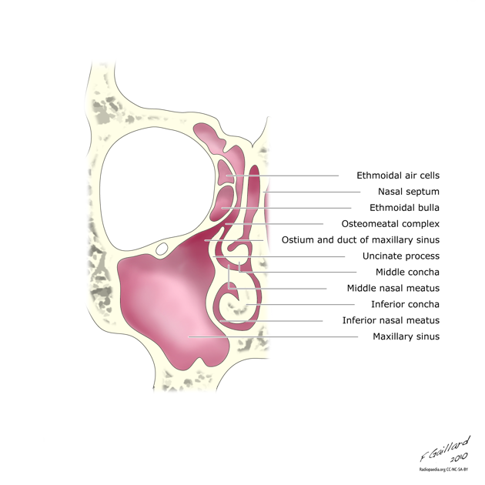
Osteomeatal complex

Slide 9
Symptoms
Multiple polypi.
Nasal stuffiness leading to nasal obstruction.
Partial or total loss of smell
Headache
Sneezing/watery nasal discharge
Mass protruding from nostrils

Slide 10
Signs
Smooth, glistening, grapelike masses, often pale in colour.
May be sessile or pedunclated, insensitive to touch,
Long standing cases may present with broadening of nose and increase in inter-canthal distance.

Slide 11
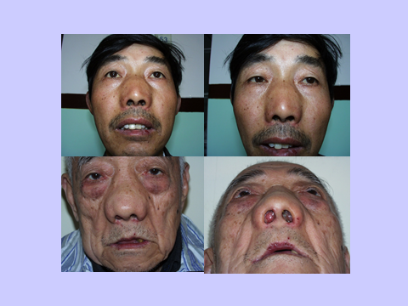

Slide 12
Ethmoidal Polyps
Anterior Rhinoscopy
Nasal Endoscopy

Slide 13
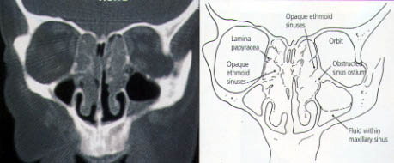

Slide 14
DD
Ethmoidal polyps are typically multiple and bilateral.
In case of nasal bleeding, pain and unilaterality, malignant tumours and inverted papilloma, and in child meningocoeles should be ruled out.
HPE always necessary

Slide 15
Treatment
Can be medical or surgical
Medical includes intranasal or systemic steroids and Leukotrine inhibitors.
Primary treatment consists of I/N steroids
A short course of systemic steroids can serve as ‘medical polypectomy’.
In more severe cases surgery is required, in moderate cases it is simple polypectomy and in severe cases FESS.

Slide 16
Antrochoanal polyp

Slide 17
Antrochoanal polyps (ACPs) are benign polypoid lesions arising from the maxillary antrum and they extend into the choana.
ACPs usually have three components and these are the cystic and solid polypoid parts.
ACPs are almost always unilateral, although bilateral ACPs have been reported.

Slide 18
ACP or Killian polyp arises from the inflamed and edematous mucosa of the maxillary antrum and they consist of three components; the antral one is almost always cystic and the other is solid.

Slide 19
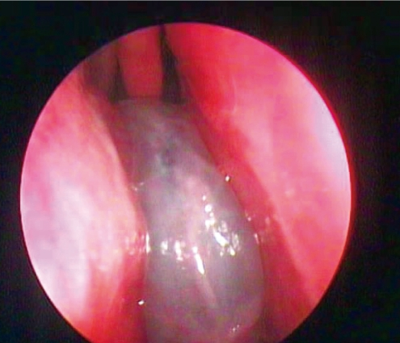
ACP passes through the maxillary ostium into the middle meatus, with extension into the nasopharynx / oropharynx.
The cystic component mostly originates from the posterior, inferior, lateral or medial walls of the maxillary antrum, and it attaches to the solid polyp with a pedicle in the nasal cavity

Slide 21
Epidemiology
ACP represent only approximately 3-6% of sino-nasal polyps.
The exact aetiology is not known, but it is thought that infection may be a common causative association.
Chronic sinusitis is found in approximately 25% of patients , but again, a causal relationship has not been firmly established.

Slide 22
Unlike other sinonasal polyps, ACPs are usually found in non-atopic patients
They are most commonly seen in young adults and in 3rd to 5th decades.
They are slightly more common in males compared to females.

Slide 23
The presenting symptoms
Nasal obstruction
Rhinorrhea
Snoring
Headache
Mouth breathing
Epistaxis
Anosmia
Halitosis
Dyspnea
Dysphonia and nasal pruritis

Slide 24
Radiographic features

Slide 25
Plain film
Unilateral opacification of the maxillary sinus
Nasopharyngeal mass is occasionally seen
Frequently bilateral sinus involvement

Slide 26
CT
Defined mass with mucin density is seen arising within the maxillary sinus
Widening of maxillary ostium and extending in to nasopharynx
No associated bony destruction but rather smooth enlargement of sinus

Slide 27
DD
Juvenile angiofibroma
Nasal glioma
Meningoencephalocele
Inverted papilloma
Mucocele
Mucus retention cyst
Tornwalt's cyst
Grossly enlarged adenoids
Lymphoma
Nasopharyngeal malignancies

Slide 28
Treatment
The treatment of ACP is always surgical.
Simple polypectomy and a Caldwell Luc procedure were the previously preferred methods for surgically treating ACPs.
In recent years, functional endoscopic sinus surgery (FESS) became the more preferred surgical technique.

Slide 29
Ethmoidal Polypi
Antrochoanal Polyp
Seen in adults
Allergy is the common cause
Multiple (bunch of grapes)
Arise from ethmoidal labyrinth
Seen easily on anterior rhinoscopy
Mostly bilateral
Recurrence is common
Polypectomy, FESS, External Procedures
Seen in children & adolescents
Infection is the common cause
Unilateral
Arises from maxillary antrum
Seen commonly in post nasal exam
Usually unilateral
Recurrence is less common
Caldwel luc surgery in recurrent cases

Slide 30
Key Points
In most cases etiology is unknown
Polyps are associated with asthma, aspirin sensitivity, cystic fibrosis.
Symptomatic nasal polyps occur in 2% pts.
Osteomeatal complex is most common site.
Unilateral polyps should always be regarded with suspicion and HPE is needed to rule out malignancy

